Slide 1

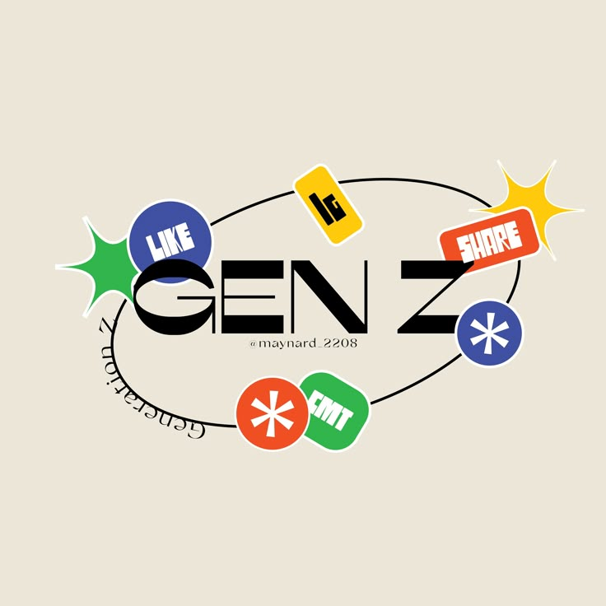

UNDERSTANDING CAREER ASPIRATIONS & WORKPLACE EXPECTATIONS OF GEN-Z
By Hemavarshini J.P

Slide 2

DESIGN AND VISUALIZATION
FOUR KEY LEARNINGS IN DATA ANALYTICS
DATA-DRIVEN APPROACH
How to approach business problems using data by clearly defining the problem, identifying what data is needed, and applying analytical methods to generate actionable insights.
DATA CLEANING AND EDA
DATA-DRIVEN APPROACH
HANDS-ON EXPERIENCE WITH INDUSTRY TOOLS

Slide 3

DESIGN AND VISUALIZATION
HANDS-ON EXPERIENCE WITH INDUSTRY TOOLS
SQL for querying and analyzing databases
Excel for executive summaries and reporting
Power BI for building interactive dashboards
DATA CLEANING AND EDA
DATA-DRIVEN APPROACH
HANDS-ON EXPERIENCE WITH INDUSTRY TOOLS

Slide 4

DESIGN AND VISUALIZATION
DATA CLEANING AND EDA TOOLS
Clean, format, and standardize raw data
Perform Exploratory Data Analysis (EDA) to discover trends, outliers, and insights These steps are crucial before drawing any conclusions from data
DATA CLEANING AND EDA
DATA-DRIVEN APPROACH
HANDS-ON EXPERIENCE WITH INDUSTRY TOOLS

Slide 5

DESIGN AND VISUALIZATION
DASHBOARD DESIGN AND VISUALIZATION SKILLS
Designing clear, functional, and visually appealing dashboards using Excel and Power BI. This includes:
Choosing the right charts and visuals
Creating user-friendly layouts
Turning data into insights that support business decisions
DATA CLEANING AND EDA
DATA-DRIVEN APPROACH
HANDS-ON EXPERIENCE WITH INDUSTRY TOOLS

Slide 6
GENERAT
IONS
SILENT
(1928 –
1945)
Millennials
(Gen-Y)
(1981 – 1996)
BOOMERS
(1946 – 1964)
Gen- X
(1965 – 1980)
Gen-Z BORN
(1997 –
2012)
ALPHA BORN
(2013 –
2025)

Slide 7
GENERAT
IONS
Millennials
(Gen-Y)
(1981 – 1996)
Gen- X
(1965 – 1980)
BOOMERS
(1946 – 1964)
SILENT
(1928 –
1945)
ALPHA BORN
(2013 –
2025)
Gen-Z BORN
(1997 –
2012)

Slide 8
ROADMAP
06 EXCEL DASHBOARD
Created an Executive Dashboard in Excel presents key performance indicators (KPIs) and metrics in a visual format to support quick, data-driven decision-making
04 EXPLORATORY DATA ANALYSIS
Exploratory Data Analysis (EDA) is the process of visually and statistically examining data to uncover patterns, trends, and relationships.
08 PRESENTATION
Worked on an employer-focused project, creating recommendations and emphasizing the importance of storytelling in data.
02 DATA COLLECTION
Created a Google Form with tailored questions to collect data on Gen-Z's career aspirations.
07 POWER BI DASHBOARD
Created a Power BI dashboard summarizing Gen-Z's learning aspirations, mission aspirations, and manager aspirations.
05 ANALYZING IN SQL
Conducted data analysis using SQL, solving complex questions with the help of Common Table Expressions (CTEs) and joins.
03 DATA CLEANING
Data cleaning involves identifying and correcting errors or inconsistencies in datasets to improve data quality and reliability.
01 PROBLEM STATEMENT
Developed a problem statement to explore and educate about the career aspirations of Gen-Z, addressing challenges and personal insights.

Slide 9
STAGE 1:
PROBLEM STATEMENT

Slide 10
PROBLEM STATEMENT
As Gen-Z rapidly enters the global workforce, organizations face challenges in understanding and aligning with their unique career aspirations, values, and workplace expectations. Gen-Z places strong emphasis on purpose-driven work, flexibility, rapid growth opportunities, and alignment with personal values.
However, there is a lack of comprehensive insights into how Gen-Z defines job satisfaction, ideal leadership, preferred work environments, and learning trajectories.
This gap creates misalignment between employers and Gen-Z employees, leading to low retention, engagement issues, and mismatched organizational strategies.
This study aims to explore and analyze Gen-Z's career goals, preferences for managerial styles, learning motivations, and mission alignment in order to help organizations create inclusive, attractive, and future-ready workplaces.

Slide 11
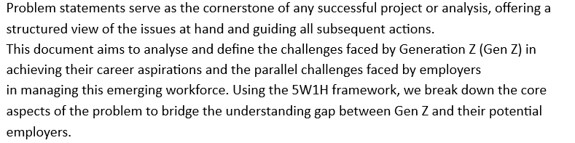
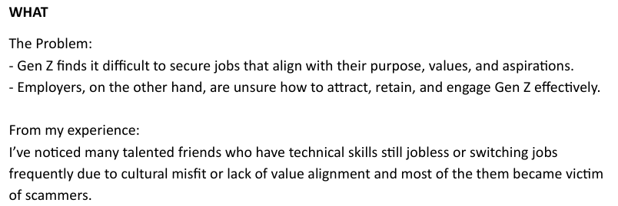
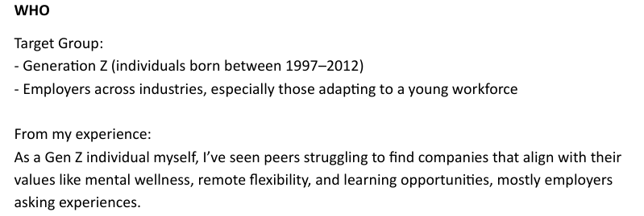
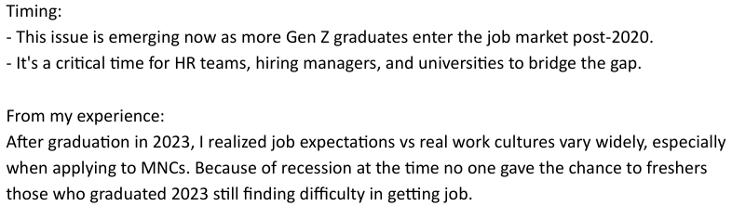
WHO IS AFFECTED?
WHAT IS HAPPENING?
WHEN IS HAPPENING?

Slide 12
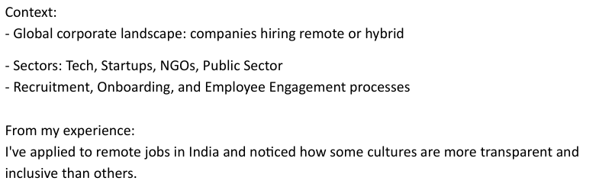
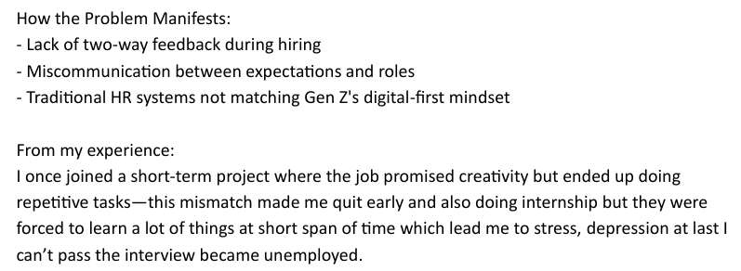
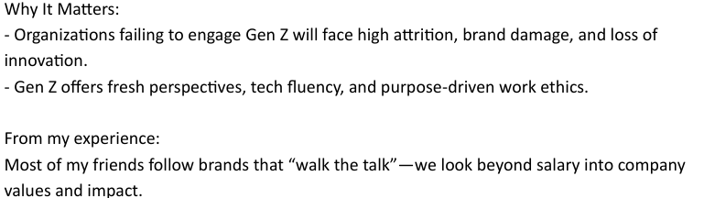
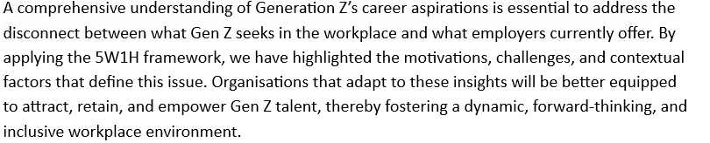
WHERE IS HAPPENING?
WHAT IS HAPPENING?
WHY IS HAPPENING?

Slide 13
STAGE 1I:
DATA COLLECTION

Slide 14
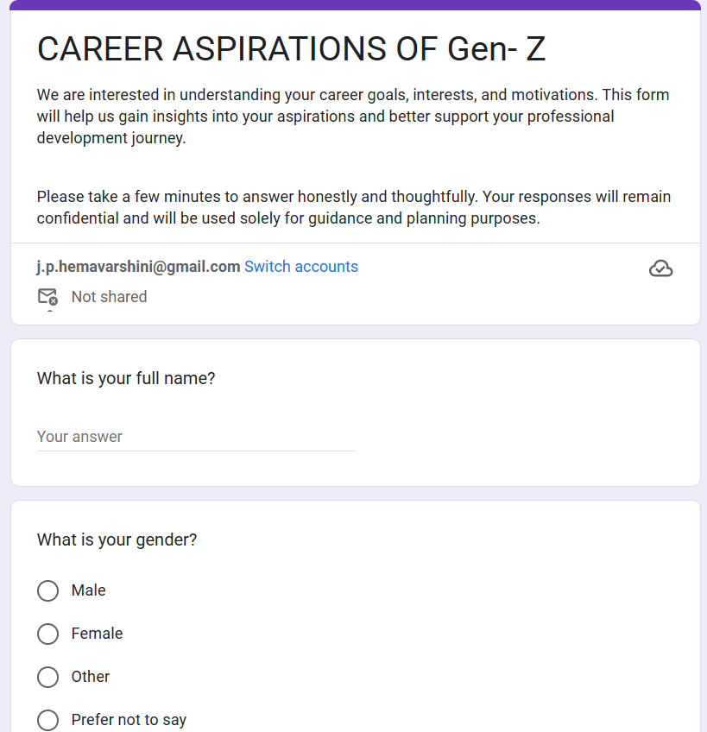
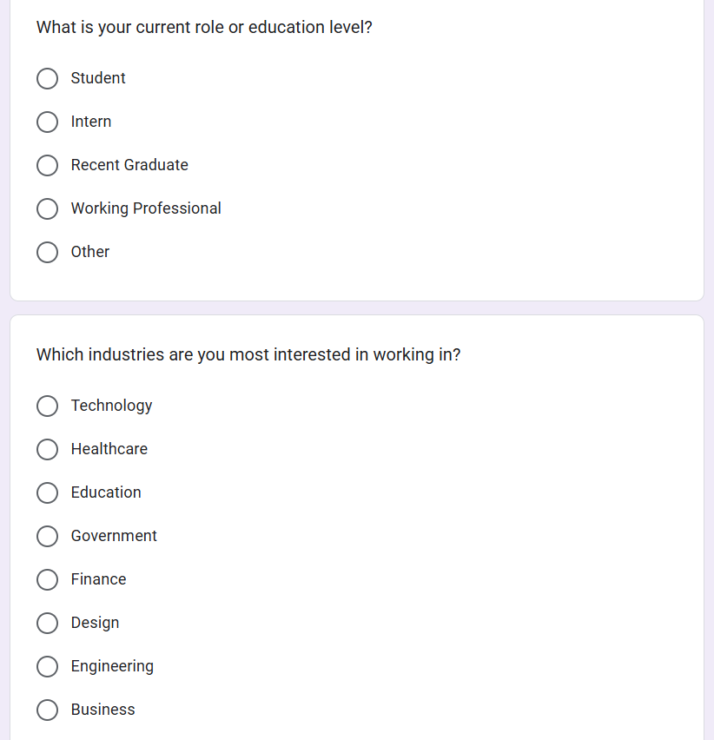

Slide 15
STAGE I1I:
DATA CLEANING

Slide 16
Business Questions
1. What industries are Gen-Z most interested in pursuing careers in?
2. What are the top factors influencing Gen-Z’s career choices?
3. What is the desired work environment for Gen-Z?
4. How do financial goals, such as salary and benefits, impact career aspirations among Gen-Z?
5. What role do personal values and social impact play in career choices for Gen-Z?
6. How often do you feel frustrated or stressed by your current or previous work experience?
7. What is Gen-Z’s preferred work setup?
8. Would you be open to staying with the same employer for at least 3 years if the job meets your expectations?

Slide 17
STAGE IV:
EXPLORATORY DATA ANALYSIS

Slide 18
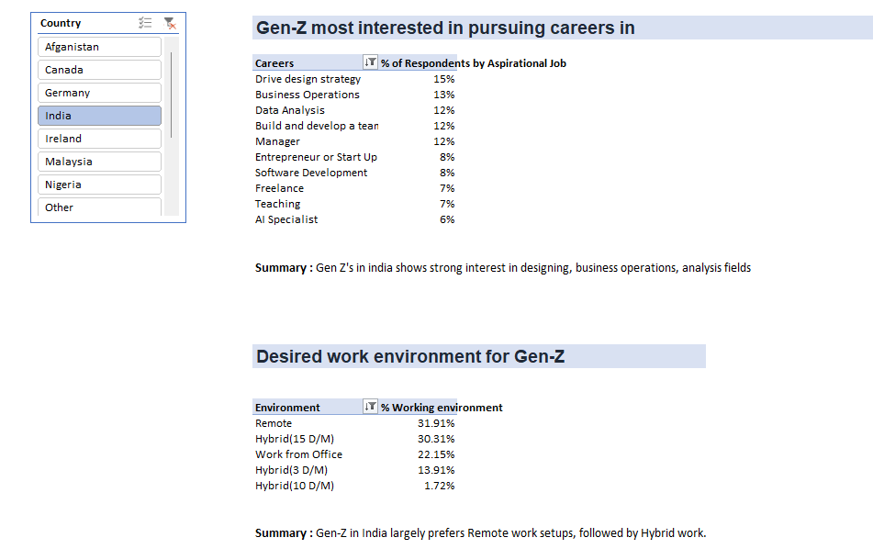
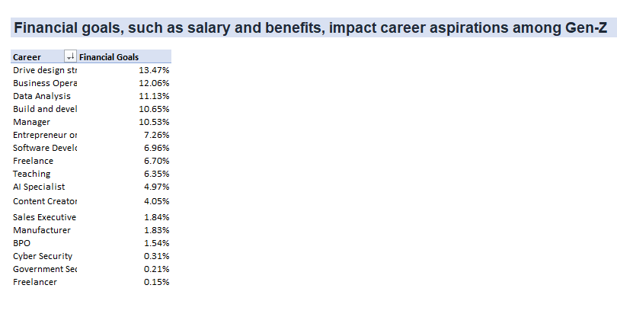

Slide 19
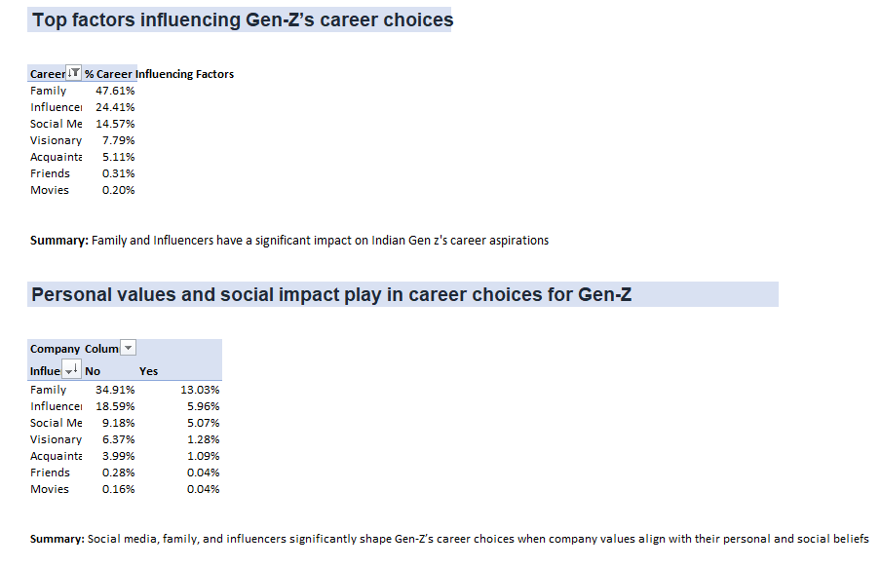

Slide 20
STAGE V:
ANALYZING IN SQL

Slide 21
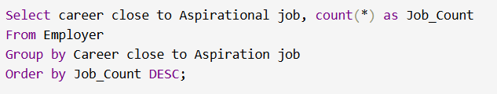
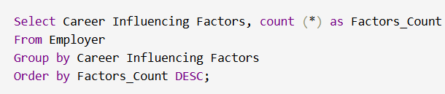
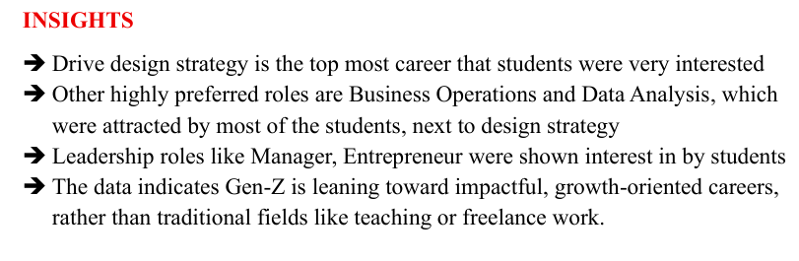
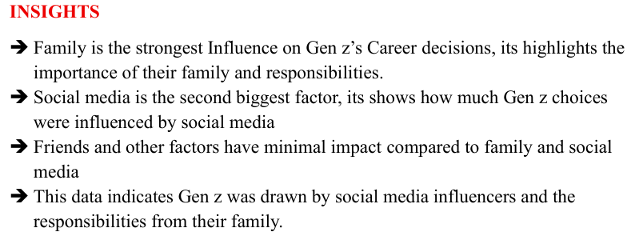
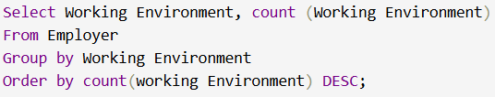
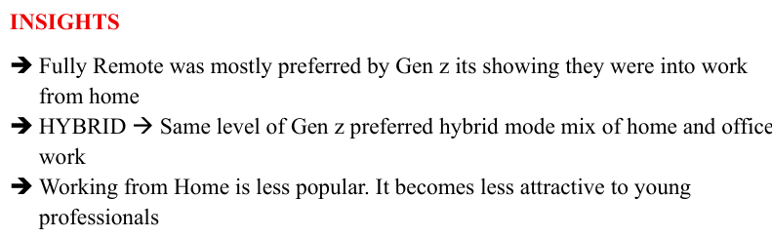

Slide 22
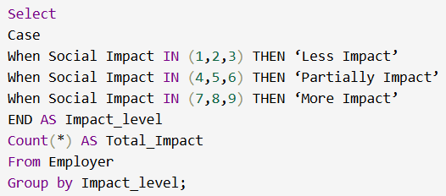
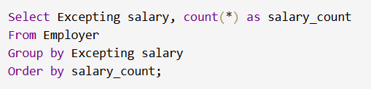
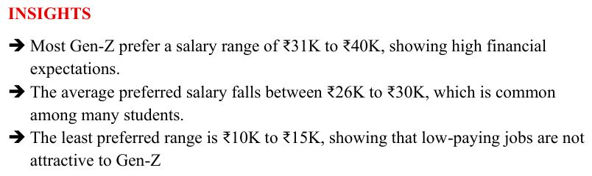
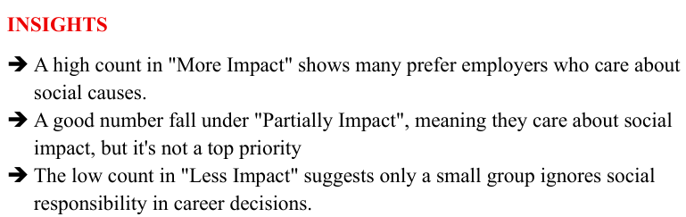

Slide 23
STAGE VI:
EXCEL DASHBOARD

Slide 24
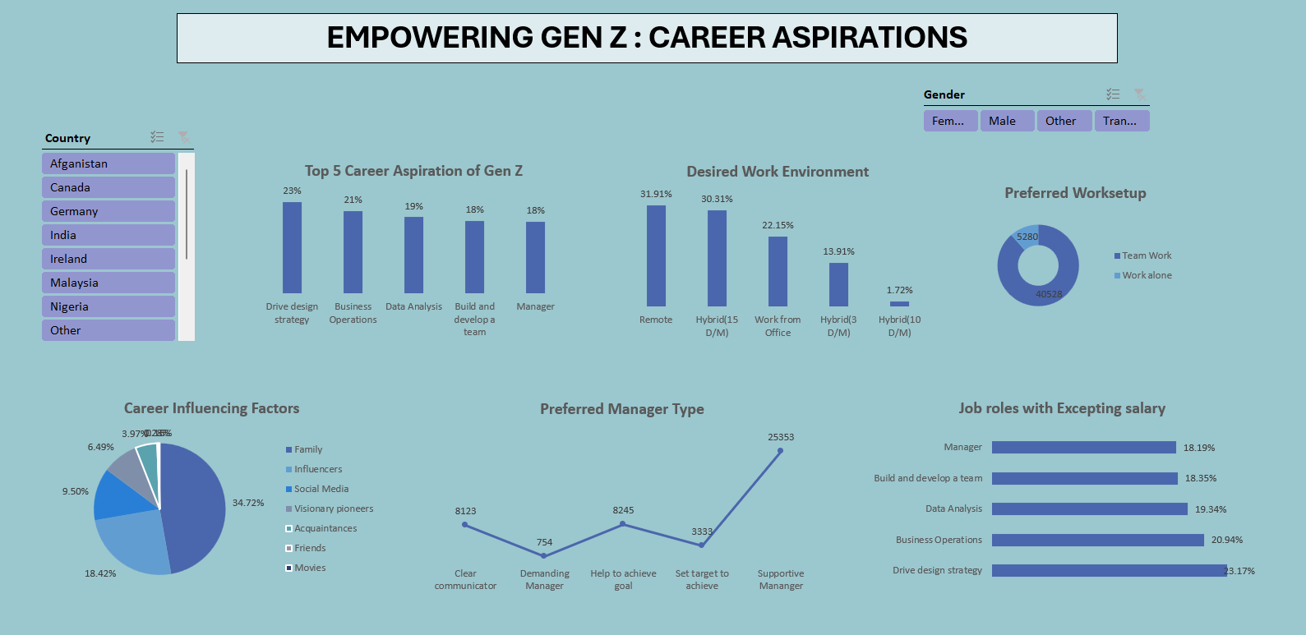

Slide 25
STAGE VII:
POWER BI DASHBOARD

Slide 26
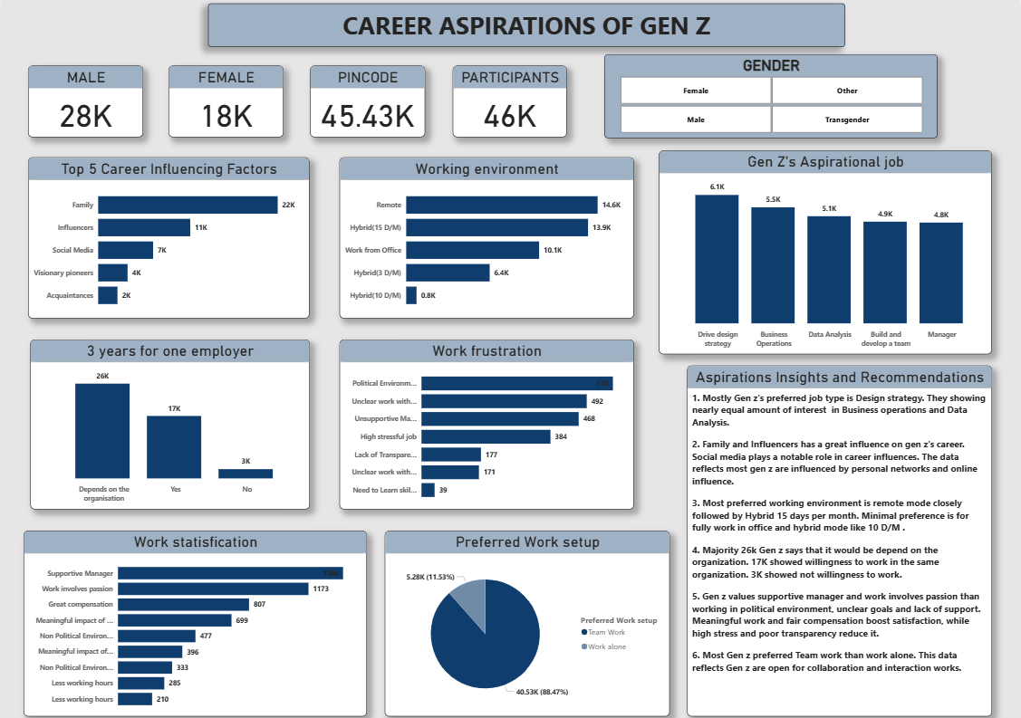

Slide 27
EXPLORING GEN Z WORK TRENDS: Analysing salary expectations, mission alignment preferences, undefined mission preferences and the impact of company missions on employee satisfaction and the impact on laid-off employees.
EXPLORING GEN Z MANAGERIAL DYNAMICS: Unveiling preferences in tenure, managerial styles, employer qualities, and team sizes for an understanding of the evolving professional landscape due to Gen Z.
LEARNING ASPIRATIONS
Gen Z Education & Career Insights: Explore Gen Z's educational preferences, top career choices, influential factors shaping their career decisions and insights into their preferred work styles.

Slide 28
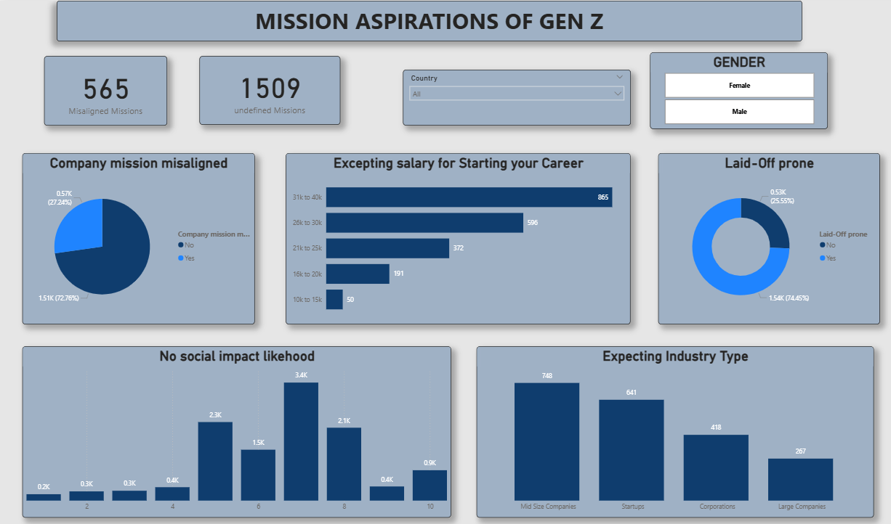

Slide 29
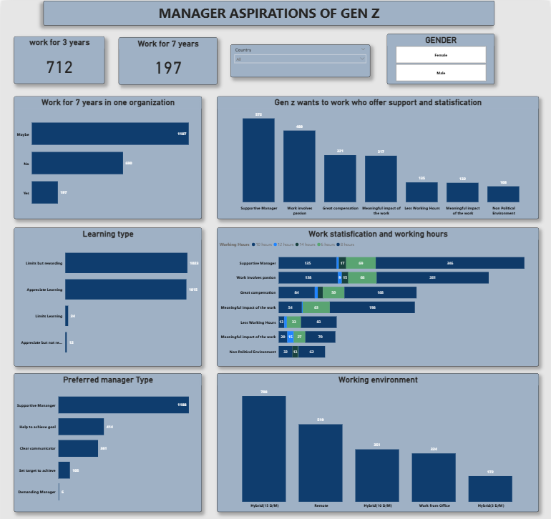

Slide 30
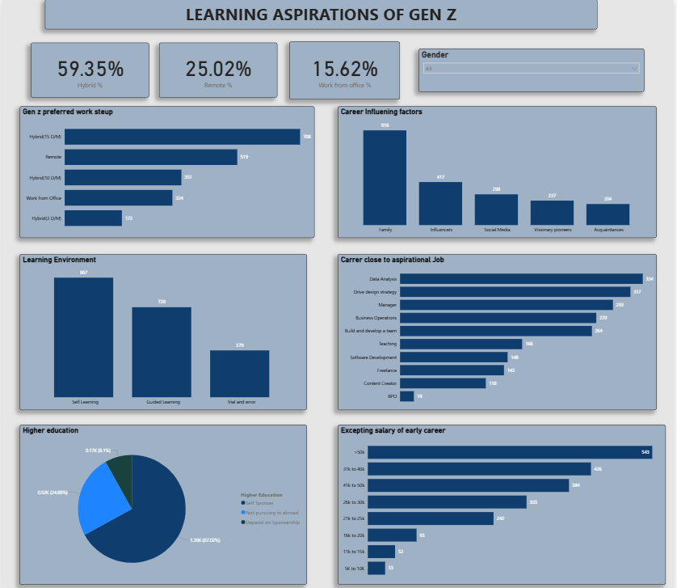

Slide 31
IBM(International Business Machines Corporation)
IBM operates globally across various technology domains, including software, hardware, cloud computing, artificial intelligence (AI), and consulting services.
Some of its major business segments include IBM Consulting, IBM Software (e.g., AI and Data, Automation), IBM Infrastructure (servers, storage), and IBM Cloud. IBM is also known for its development of advanced AI through Watson and its contributions to quantum computing.
The company is a pioneer in the tech industry and has played a key role in advancing enterprise technology for over a century. IBM serves industries such as healthcare, finance, retail, and manufacturing by offering tailored technology solutions to solve complex business challenges.
Smarter business decisions: IBM’s data analytics and AI tools help companies make informed decisions by analyzing large volumes of structured and unstructured data.
AI-powered automation: With solutions like IBM Watson, IBM helps automate workflows in customer service, HR, and IT support, reducing costs and improving efficiency.
Personalized solutions: IBM uses data to customize services for clients, recommending specific tools or strategies based on their business needs and industry trends.
Cybersecurity insights: IBM leverages big data to detect threats and prevent cyberattacks using its advanced security intelligence platforms.

Slide 32
Average Rating

Slide 33
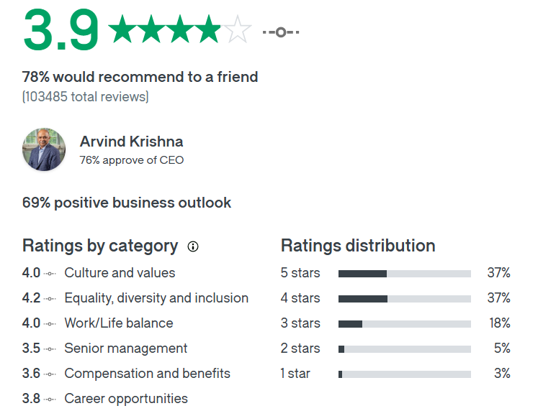
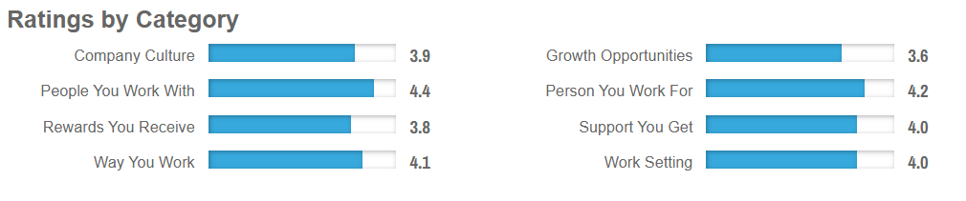
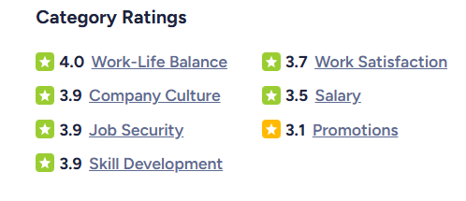
GLASSDOOR
CAREERBLISS
AMBITIONBOX

Slide 34
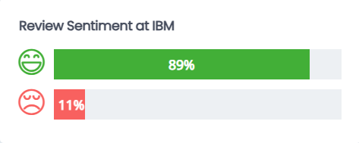
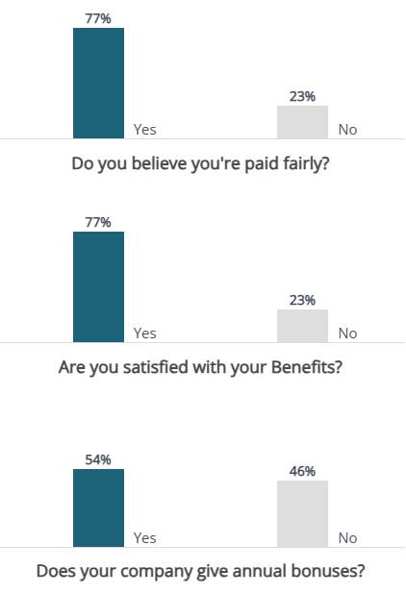
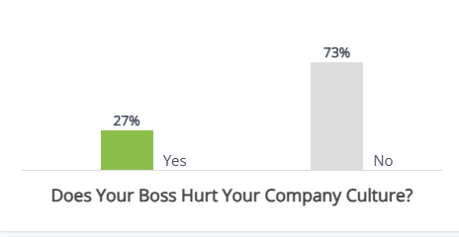
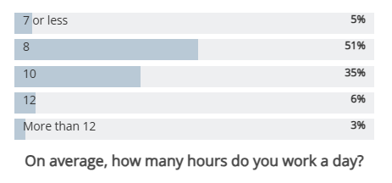

Slide 35
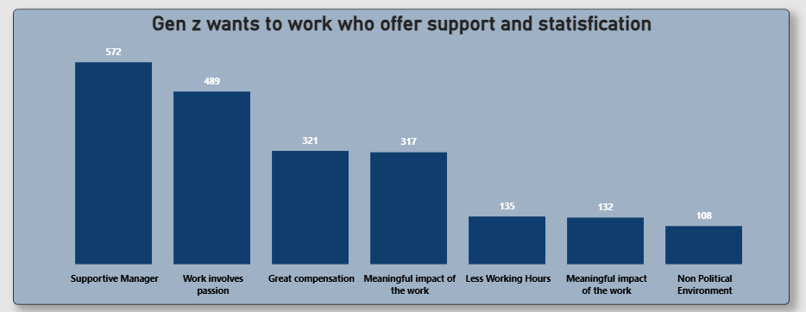
PROBLEM
Poor manager support and unclear work expectations lower Gen Z motivation
RECOMMENDATIONS
Strengthen manager leadership skills
Give clear goals and purpose
Set consistent work policies
Offer fair pay and appreciation

Slide 36
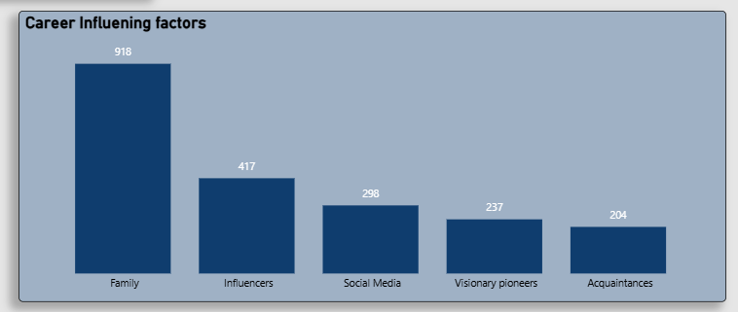
PROBLEM
Gen Z career choices are heavily influenced by others
RECOMMENATIONS
Provide career counseling and mentorship
Create awareness programs to guide unbiased choices
Encourage self-assessment of skills and interests

Slide 37
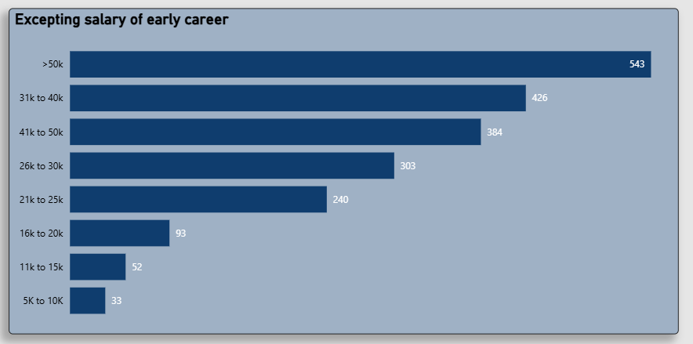
PROBLEM
Gen Z has high early-career salary expectations, often exceeding market standards
RECOMMENATIONS
Educate candidates about realistic salary ranges
Highlight long-term growth opportunities and benefits
Offer transparent pay structures and career progression plans

Slide 38


THANK YOU

